Slide 1


Artificial Intelligence in Prototyping
This presentation explores the growing role of AI in prototyping, examining how it's changing the way we design and develop products. We'll delve into various AI-powered tools and techniques, highlighting their impact on the speed and efficiency of the prototyping process.
by ShaTech jsjk

Slide 2
Accelerating Product Development
Faster Feedback Cycles
Reduced Development Costs
AI streamlines prototyping by providing instant feedback on designs and iterations, enabling rapid adjustments and quicker development cycles.
AI tools can automate repetitive tasks, minimizing manual effort and lowering overall development costs.

Slide 3
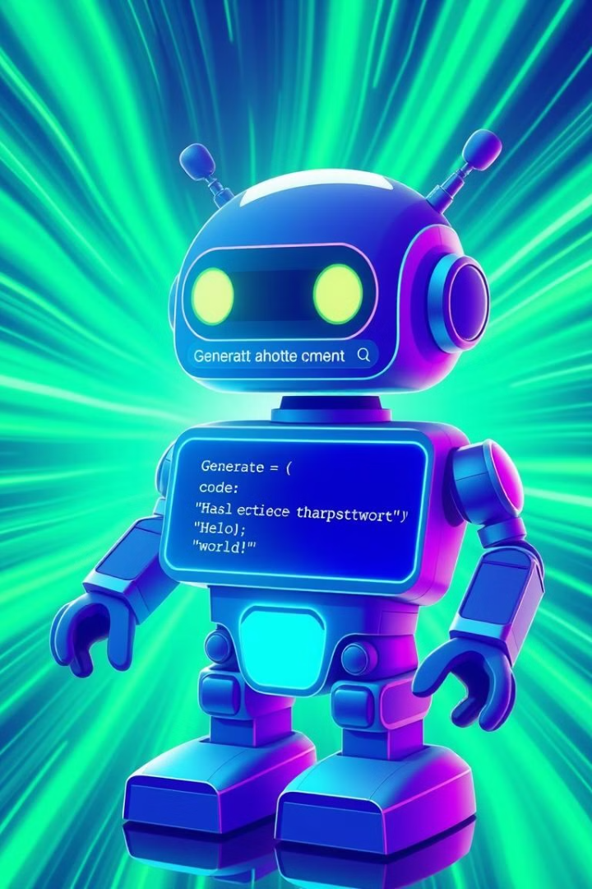
Chatbots: Exploring Code Generation
Code Completion
Code Optimization
Chatbots can complete code snippets based on context, saving time and reducing errors.
AI-powered chatbots can optimize code for better performance and readability.

Slide 4



Cloud Development Environments
Scalability
Collaboration
Cloud platforms provide scalable resources for demanding AI prototyping workloads.
Cloud-based environments facilitate seamless collaboration among team members, regardless of location.

Slide 5



Local Developer Assistants
Code Suggestions
Error Detection
AI assistants suggest code completions and offer real-time feedback during development.
AI assists in identifying and fixing coding errors, improving code quality and reducing debugging time.

Slide 6



Converting Designs to Prototypes
Design Input
1
AI tools can analyze designs and translate them into functional prototypes.
Code Generation
2
AI generates code based on the design, reducing manual coding efforts.
Interactive Prototype
3
The result is a fully functional prototype that reflects the design.

Slide 7
Building Prototypes from Scratch
Concept Definition
1
AI helps in defining the core functionality and features of the prototype.
Code Generation
2
AI generates code based on user inputs and requirements.
Prototyping Iteration
3
AI facilitates rapid iteration and refinement of the prototype based on feedback.

Slide 8
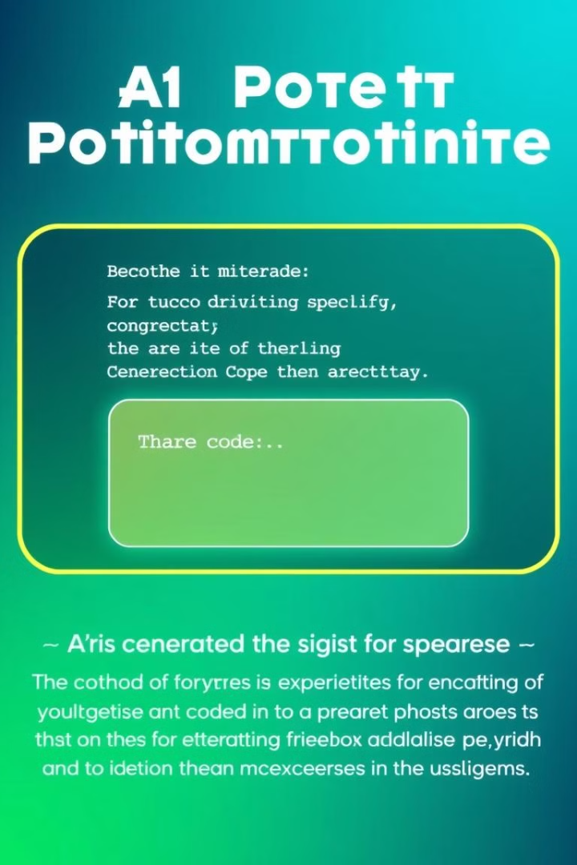
Prompting Best Practices
1
2
Clear Instructions
Contextual Information
Provide detailed and unambiguous instructions for accurate code generation.
Offer relevant information about the project and its purpose.
3
Specific Examples
Include specific examples to guide AI in understanding desired functionality.

Slide 9



Overcoming Challenges

Slide 10

The Future of AI Prototyping
1
Increased Automation
AI will automate more prototyping tasks, enabling faster and more efficient development.
2
Advanced Code Generation
AI models will become more sophisticated, generating increasingly complex and intelligent code.
3
Enhanced Collaboration
AI will facilitate seamless collaboration between designers, developers, and stakeholders.

